Slide 1
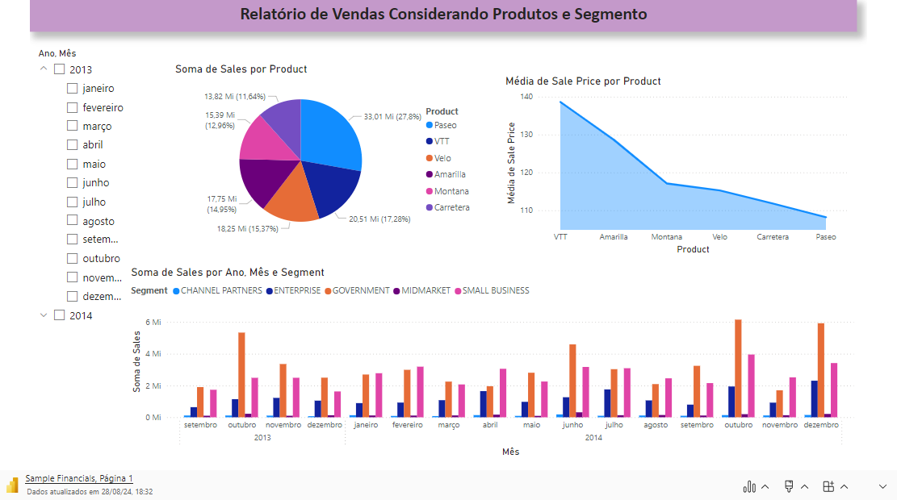
Sample Financials

Slide 2
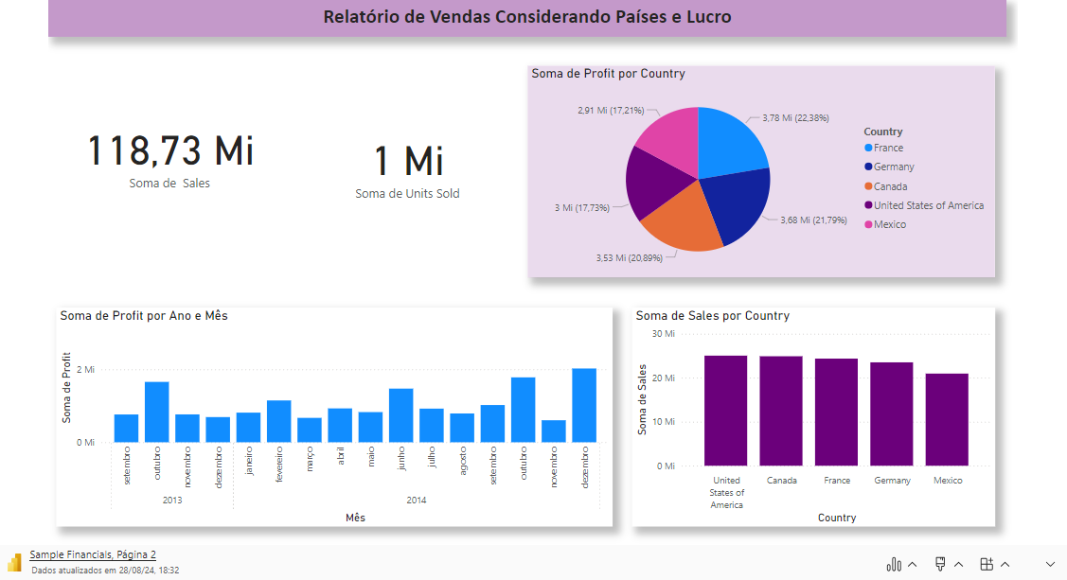
Sample Financials

Slide 3
